Slide 1
Master-slave & Peer to Peer replication database
2023004177 – S.Prasanth – M.Tech DataScience

Slide 2
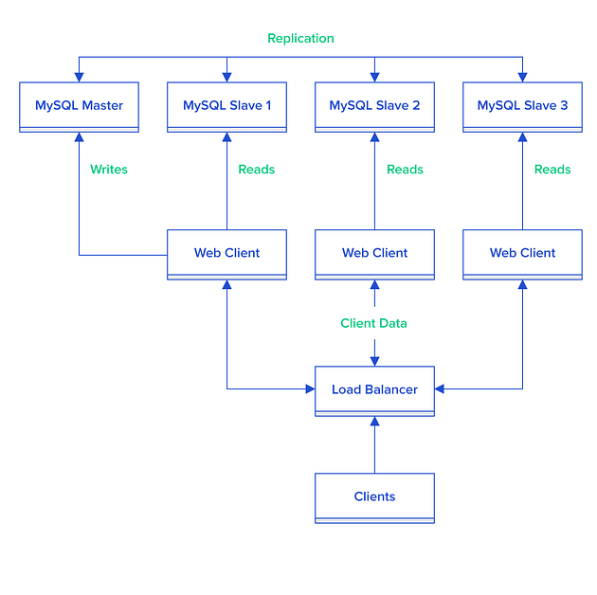
WHAT IS THE MASTER-SLAVE DATABASE?
The master-slave is a database architecture divided into a master database and slave databases. The slave database serves as the backup for the master database. The master database is used for the write operations, while read operations may be spread on multiple slave databases.
Imagine a situation where your site is bombarded with multiple data requests causing a surge in web traffic. Now if there is only one master database, then it will be overloaded, making the site slower for all your users.
To scale out your application, you need two data sources- one to handle the write operations and the other one to handle the read operations. And that’s where master-slave architecture comes in handy.
Master-slave replication can be either synchronous or asynchronous. The difference is simply the timing of propagation of changes. If the changes are made to the master and slave at the same time, it is synchronous. If changes are queued up and written later, it is asynchronous.

Slide 3
Pros of Master-Slave Database Architecture
How it works:
1
Produce backups: provide reliable backups through their chain of slave databases. The slave database can be shut down without affecting the operations of the master database, because the snapshots of the live data will be replicated onto the slave database, even after a failure in master databases.
2
Scale out the application: When users grow, it’s important to provide seamless user experience to your users. Master-Slave architecture can be used for scaling out your application by distributing your data load across multiple databases.
3
Spreading the load: There may be situations when we have a single master and want to replicate different databases to different slaves. For example, we may want to distribute different sales data to different departments to help spread the load during data analysis.
4
Increasing the performance: as the number of slaves connecting to a master increases, the load, although minimal, also increases, as each slave uses a client connection to the master. Also, as each slave must receive a full copy of the master binary log, the network load on the master may also increase and create a bottleneck. If we are using a large number of slaves connected to one master, and that master is also busy processing requests (for example, as a part of a scale-out solution), then we may want to improve the performance of the replication process. One way to improve the performance of the replication process is to create a deeper replication structure that enables the master to replicate to only one slave, and for the remaining slaves to connect to this primary slave for their individual replication requirements

Slide 4
Cons of Master-Slave Database Architecture
Write operations to master are hard to scale — Write requests to master can hardly be scaled. One of the only few options to scale the writing requests is to increase the compute capacity(CPU and ROM) of the master database.
Asynchronous replication fails at times — Asynchronous means two or more operations taking place in a system that is independent and does not rely upon or affect each other. This asynchronous replication followed in the master-slave database is not very reliable as the changes committed to the master may not be reflected in the slave nodes if there is a failure in the master node.
No automatic failover — In case a master fails, a slave should be pushed to take the place of the master. No automatic failover replacement ensues.
Binary log has to be read each time data is copied — Each slave adds load to the master as the binary log has to be read before copying data to the slave nodes.

Slide 5
Peer-to-Peer Replication?
In database systems, replication is the process of sharing data across multiple nodes to ensure redundancy, scalability, and fault tolerance. Peer-to-peer replication is a distributed data replication model where each node can act as both a source and a destination for data, allowing for decentralized data sharing.
Peer-to-Peer Network: In a peer-to-peer network, all nodes have equal status and can communicate directly with each other.
Data Replication: Data replication involves copying data from one database to another, ensuring that all nodes in the network have consistent and up-to-date information.
Comparison with Other Models: Unlike master-slave or master-master replication models, peer-to-peer replication allows for more decentralized and flexible data sharing.
.

Slide 6
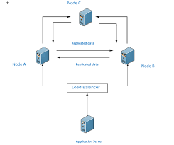
Peer-to-Peer Architecture?
Components: Peer-to-peer replication architecture consists of multiple nodes, each capable of initiating data replication, receiving replicated data, or serving as an intermediate node.
Node Roles: Nodes can take on different roles such as initiator, target, or intermediary, depending on their function in the replication process.
Data Distribution Strategy: Various strategies can be employed to distribute data among nodes, including partitioning and sharding.

Slide 7
Peer-to-Peer Advantages and Challenges
Advantages
Increased Fault Tolerance: Redundancy across multiple nodes ensures that if one node fails, others can continue to serve data.
Improved Scalability: Adding more nodes to the network allows for better handling of high loads and increased data volume.
Enhanced Performance: Load balancing and parallel processing capabilities improve overall system performance.
Challenges
Data Consistency: Ensuring that data remains consistent across all nodes despite concurrent updates.
Network Overhead: Increased network traffic due to data replication activities.
Conflict Resolution: Resolving conflicts that arise when multiple nodes attempt to update the same data simultaneously.

Slide 8
DIFFERENCE BETWEEN PEER TO PEER AND MASTER SLAVE REPLICATION
FEATURE | PEER TO PEER | MASTER SLAVE
Architecture | All nodes have equal status and can act as both sources and destinations for data. Data can be replicated bidirectionally between any pair of nodes in the network. No central authority or master node controls the replication process. | Involves a primary/master node and one or more secondary/slave nodes. Replication occurs unidirectionally from the master node to the slave nodes. The master node controls the replication process, and slave nodes receive updates from the master.
Data Consistency | Ensuring data consistency across all nodes can be more challenging due to bidirectional replication. Conflict resolution mechanisms are necessary to handle conflicts that arise from simultaneous updates on different nodes. | Data consistency is typically more straightforward as updates flow unidirectionally from the master to the slaves. Slaves are always consistent with the master's state, reducing the likelihood of conflicts.
Fault Tolerance: | Offers increased fault tolerance as each node holds a copy of the data. If one node fails, other nodes can continue to serve data, reducing the risk of data loss or service interruption. | Relies heavily on the availability of the master node. If the master node fails, replication halts until a new master is promoted or failover mechanisms are triggered, potentially leading to downtime.

Slide 9
FEATURE | PEER TO PEER | MASTER SLAVE
Scalability | Generally more scalable as new nodes can be added to the network without significant impact on the overall system. Distributes the load evenly across nodes, allowing for better performance as the network grows. | Scaling may be limited by the capacity and performance of the master node. Adding more slaves can improve read scalability, but writes are still bottlenecked by the master's capacity.
Complexity | Can be more complex to implement and manage due to the decentralized nature of the network. Requires robust conflict resolution mechanisms and careful design to ensure data consistency. | Generally simpler to set up and manage, particularly in scenarios where a single authoritative source of data (the master) suffices. Failover and recovery procedures are more straightforward since there's a clear distinction between master and slave nodes.

Slide 10
CONCLUSION
Having a master-slave replication configured in your development environment is useful if you need it for a scale-out solution in the production environment. Although it is extremely robust, the underlying complexity is difficult and the cost for renting and maintaining separate databases and servers may outweigh the benefits offered by this master-slave architecture.
Peer-to-peer replication offers a decentralized approach to data sharing, providing benefits such as increased fault tolerance, scalability, and performance. Understanding its architecture, challenges, and best practices is crucial for leveraging its full potential in modern distributed systems.

Slide 11
THANK YOU

